Slide 1

Wordpress Migration Project

Slide 2
About us
Nam Tran
Trang Nguyen
Huong Nguyen

Slide 3
Agenda
Introduction
Our project
Real project
Practice
Conclusion

Slide 4
Introduction

Slide 5
About project
Project Name: Bonnier Migration
Mentors: Mr. Ngoc Tran and Mr. Tuan Ta
Members:
Huong Nguyen
Trang Nguyen
Nam Tran

Slide 6
Project Purpose
CMS Migration
The process of moving information or data which already stored on a Web content management system (CMS) to a new system.
Notes:
Migrating from

Slide 7
Project Purpose (cont.)
Migrate content from EpiServer to Wordpress
Upgrade old Wordpress version to the latest Wordpress core version
Ensure:
The CMS platform changed
Website remains functionally, work smoothly on new platform

Slide 8
Our project

Slide 9
Real Project
What is Wordpress?
Definition
Wordpress themes
Wordpress actions and filters
Why do we need a child theme?
What did we really do?
Requirements
Resolved problem

Slide 10
Wordpress

Slide 11

Wordpress
Notes:
Wordpress is a CMS (Content Management System)
Do the connection and interative with database. Everything is based on post type. You will interact with database by using Wordpress’s own function

Slide 12
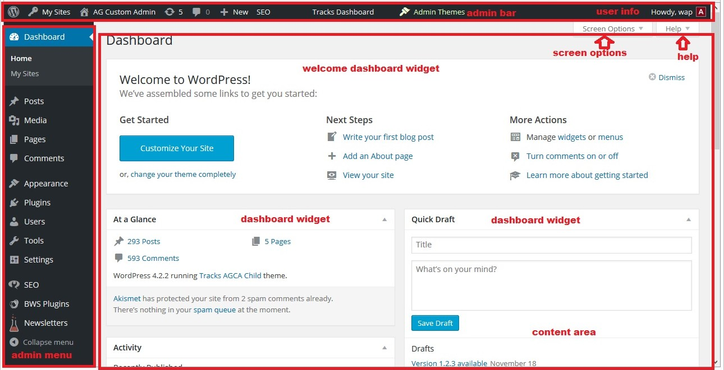

Slide 13
Wordpress theme
A WordPress theme changes the design of
your website, often including its layout
Themes take the content and data stored by
WordPress and display it in the browser

Slide 15
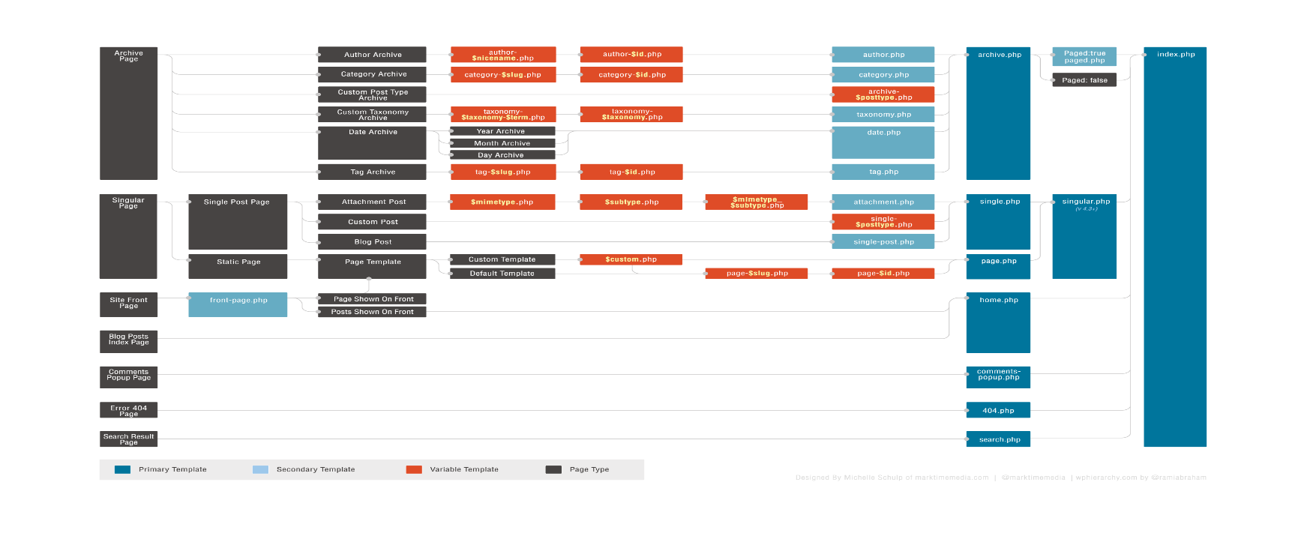
Wordpress hierarchy
Checkout here: https://wphierarchy.com/

Slide 16
Wordpress actions and filters
A WordPress theme changes the design of your
website, often including its layout
Themes take the content and data stored by
WordPress and display it in the browser

Slide 17
Why we need a child theme
Wordpress Themes are all of files that work together to create the design and functionality of a Wordpress site.
You do not need to focus on how you connect and interactive with the database. Wordpress does it and you can use it’s own database function

Slide 18
What we have done

Slide 19
Requirements
Make a copy of damernasvarld-blog child theme and implement new theme
101 ideer’s blogs and M-magasin blogs should be based on the damernasvarld-blog child theme. The end result should be similar to the setup shown on this site: http://elin.damernasvarld.se/
Change some styles that mentioned in requirement documentation

Slide 20


Slide 21
Assigned tasks
Setup Environment, database and configuration (create fake domain name in vhost file, replace that domain in database …)
Change styles based on requirements documentation and make the new theme same as the damernasvarld-blog
Verify the new theme and fix bugs
Deploy the project on local dev server and customer’s server

Slide 22
Problem
Too large database -> take time to import
Use PHP Myadmin
Wordpress multisite

Slide 23
Demo websites

Slide 24
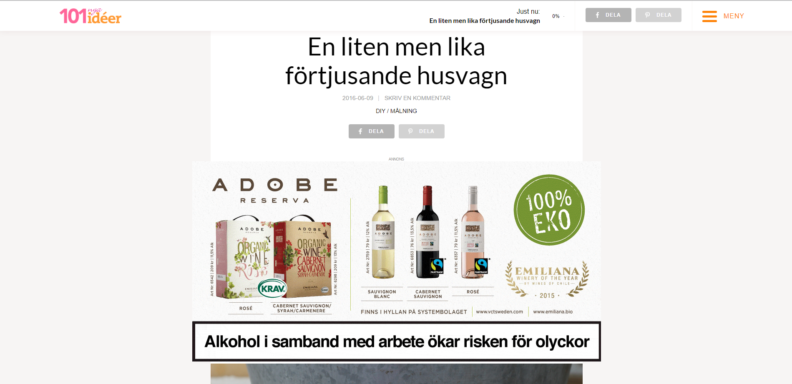

Slide 25
Practice: Alfuttaim – Home page
Requirements:
Build the Alfuttaim home page from its design (.psd file)
Use Handlebars, Sass and Grunt
Do it as a team

Slide 26
Practice: Alfuttaim – Home page
Solutions:
Learn Handlebars and Sass
Divide the design into sections
Work independently
Use convention to avoid conflicts
Daily meetings
VCS: Git

Slide 27
Practice: Alfuttaim – Home page
Results:
The Alfuttaim home page looks as designed
Skills:
Teamwork
Avoiding and resolving conflicts
Using new tools

Slide 28
Conclusion

Slide 29
Achievement
Basic HTML, CSS (Bootstrap), JavaScript (jQuery)
Wordpress Basic:
Theme development
Actions and filters
Grunt, Handlebars, Sass
Teamwork: Daily meeting, using Jira, Confluence, BitBucket, Git

Slide 30
Limited issues

Slide 31
Thanks for listening

Slide 32
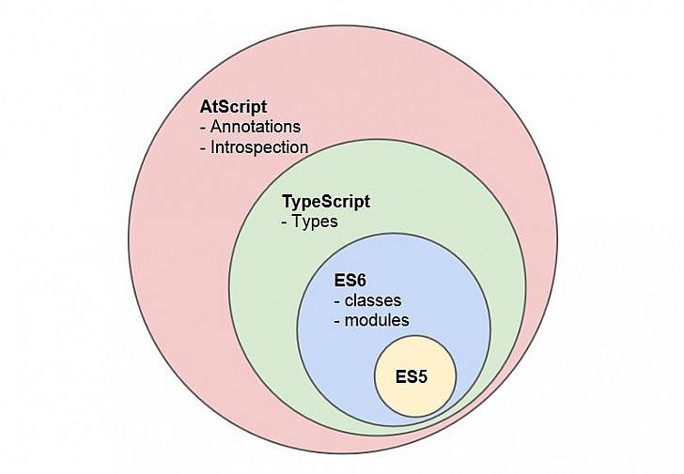
What is Typescript ?
Superset of JavaScript that compiles to plain JS
Any Browser, any host, any OS
Notes:
“TypeScript is a free and open source programming language developed and maintained by Microsoft. It is a strict superset of JavaScript, and adds optional static typing and class-based object-oriented programming to the language.”
TypeScript will be transpiled to pure JavaScript

Slide 33
What is Typescript ?
Transpilation
Source to source compilation
Creates a map file
Why is it needed?
Modern browsers cant understand TS
Built into Visual Studio

Slide 34
https://www.typescriptlang.org/play/

Slide 35
Typescript includes:
Classes
Modules
Arrow function
Default, optional
…
And all the awesome features of ES6!
(http://es6-features.org/)

Slide 36
Typescript includes:
New basic types
Boolean
Number (float)
String
Array (one type)
Enum
Any - general type
Void - empty type

Slide 37
Typescript includes:
Class
Interface
Inheritance
Generic

Slide 38
Why typescript ?
Type-checking
ES6 Feature Support.
JavaScript interoperability
IDE support
Run everywhere.
Notes:
Compile time error checking, intellisense, refactoring
JavaScript is dynamically typed. This means JavaScript does not know what type a variable is until it is actually instantiated at run-time. This also means that it may be too late. TypeScript adds type support to JavaScript. Bugs that are caused by false assumptions of some variable being of a certain type can be completely eradicated if you play your cards right; how strict you type your code or if you type your code at all is up to you.
Since TypeScript is so closely related to JavaScript it has great interoperability capabilities, but some extra work is required. You need a TypeScript definition, so that Typescript knows for example that when you're calling some function called jQuery it actually exists somewhere and is not a typo on your part. These definitions are placed in .d.ts files.
To use TypeScript you need a build process to compile to JavaScript code. The build process generally takes only a couple of seconds depending of course on the size of your project. The TypeScript compiler supports incremental compilation (--watch compiler flag), so that all subsequent changes can be compiled at greater speed.

Slide 39
Why typescript ?
Roadmap
https://github.com/Microsoft/TypeScript/wiki/Roadmap

Slide 40
Angular 2

Slide 41
Overview
Angular 2 is the next version of Google’s massively popular MV* framework for building complex applications in the browser.
Angular 2 comes with almost everything you need to build a complicated frontend web or mobile apps, from powerful templates to fast rendering, data management, HTTP services, form handling, and so much more.
https://angular.io/features.html.

Slide 42
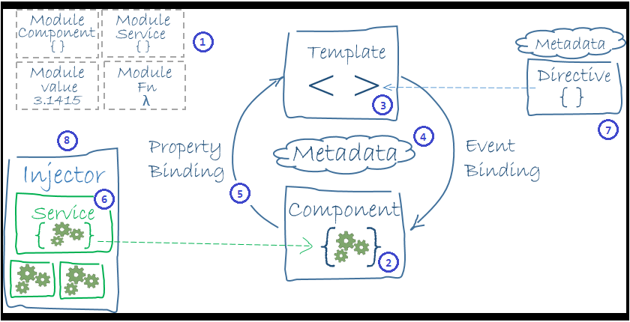
Angular 2 architecture

Slide 43
Angular 2 architecture
Module
Component
Template
Metadata
Data Binding
Service
Directive
Dependency Injection

Slide 44
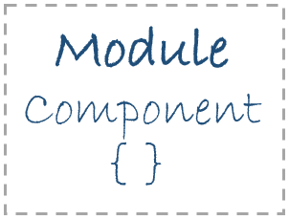
Angular 2 - Module
Angular apps are modular.
A typical module is a cohesive block of code dedicated to a single purpose.
A module exports something of value in that code, typically one thing such as a class. A module that needs that thing, imports it.
Notes:
Module:
Angular apps are composed of modules.
Modules export things — classes, function, values — that other modules import.
We prefer to write our application as a collection of modules, each module exporting one thing.
The angular2/core library is the primary Angular library module from which we get most of what we need.
// Angular does not ship with a module loader and does not have a preference for any particular 3rd party library (although most samples use SystemJS).

Slide 45
Angular 2 – Component &template
Component is an Angular class responsible for exposing data to a View and handling most of the view’s display and user-interaction logic.
Those familiar with "MVC" and "MVVM" patterns will recognize the Component in the role of "Controller" or "View Model".
A template is a chunk of HTML that Angular uses to render a view.
Notes:
Template
A template is a chunk of HTML that Angular uses to render a view with the support and continuing guidance of an Angular Directive, most notably a Component.
We write templates in a special Template Syntax.

Slide 46
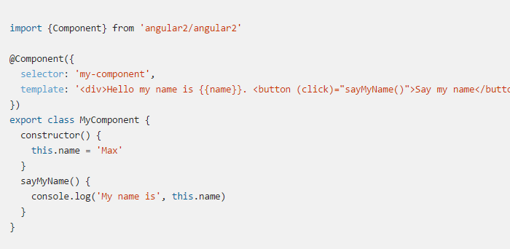
Angular 2 – Component/template
Notes:
When we use the <my-component></my-component> tag in our HTML, this component will be created, our constructor called, and rendered.
No more scopes.
In Angular 2, we don’t have controllers nor scope anymore. So… what do we use to create a page like login or home ? We use a Component.
In Angular 2 we have two types of directives. The ones that adds behavior to a DOM element and the ones that has an embedded view (template). The first one are called directives and the second one are called components
We can have more than 1 View annotation in a component. We could define a template for desktop, one for tablets, one for mobile, one for tv…
---
Template is a chunk of HTML that Angular uses to render a view
Templates are very similar to templates in Angular 1, though there are many small syntactical changes that make it more clear what is happening.
https://angular.io/docs/ts/latest/guide/template-syntax.html

Slide 47
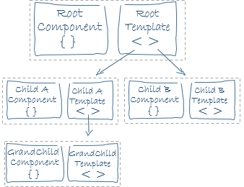
Angular 2 – Component/template

Slide 48
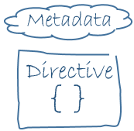
Angular 2 – Directive
Directive is an Angular class responsible for creating, re-shaping, and interacting with HTML elements in the browser DOM.
Notes:
We already met one form of directive: the component. A component is a directive-with-a-template and the @Component decorator is actually a @Directive decorator extended with template-oriented features.

Slide 49
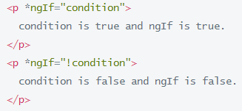

Angular 2 – Directive
Directives fall into one of three categories:
Components.
Attribute Directives: alter the appearance or behavior of an existing element.
Structural Directives: alter layout by adding, removing, and replacing elements in DOM
Notes:
Attribute: The built-in NgStyle directive
---------------
Structural: NgFor and NgIf are two familiar examples.
NgIf Case Study
The ngIf directive does not hide the element. Using browser developer tools we can see that, when the condition is true, the top paragraph is in the DOM and the bottom disused paragraph is completely absent from the DOM! In its place are empty <script> tags.
When we hide an element, the component's behavior continues. It remains attached to its DOM element. It continues to listen to events. Angular keeps checking for changes that could affect data bindings. Whatever the component was doing it keeps doing.
Although invisible, the component — and all of its descendent components — tie up resources that might be more useful elsewhere. The performance and memory burden can be substantial and the user may not benefit at all.
On the positive side, showing the element again is very quick.

Slide 50
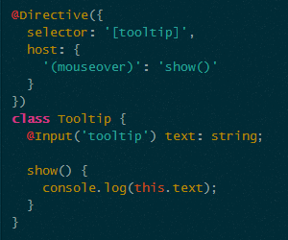
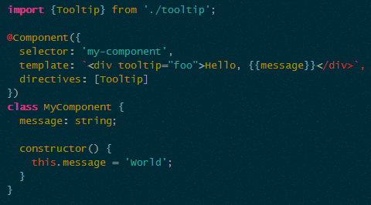
Angular 2 – Custom Directive
Directive
Usage

Slide 51
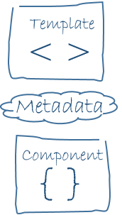
Angular 2 - Metadata
Selector
Template
TemplateUrl
Directives
Providers
…
Notes:
Metadata tells Angular how to process a class.
Looking back at the HeroListComponent, we see that it's just a class. There is no evidence of a framework, no "Angular" in it at all.
In fact, it really is just a class. It's not a component until we tell Angular about it.
We tell Angular that HeroListComponent is a component by attaching metadata to the class.
The easy way to attach metadata in TypeScript is with a decorator. Here's some metadata for HeroListComponent

Slide 52
Flashback
Web Components
Should act like existing browser elements
DOM API: properties, events, methods
HTML is serialized version of DOM
Notes:
Don’t tread fundamental element any way other than native one => nature syntax
API surface of element in general
HTML is how we serialized DOM
- html syncs the attribute and the properties and keep them constantly in sync but not all of them (cursor position, selected index, scrolling position…)

Slide 53
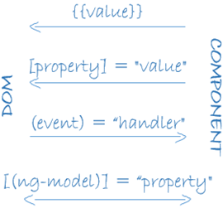
Angular 2 – Data binding
Interpolation {{ }}
Template Expressions [property]=“expression”
Produces a value
Template Statements (event)=“statement”
Responds to event
Two-way Data Binding [(target)] = “expression”
Notes:
properties
----------
Why [property] not {{expression}}
<component title=“literal”/>
<component title=“expression”/> // =
<component title=“{{interpolate}}”/> // @
=> Person who write component is decide what to write instead of who use it
NG2:
<component title=“literal”/>
<component [title]=“expression”/>
HTML Attributes => DOM properties
<input value=“initial”>
- html syncs the attribute and the properties and keep them constantly in sync but not all of them (cursor position, selected index, scrolling position…)
Properties
Var current = input.value
Attribute only understand string, property understand ‘model’
Escape & Binding to property of object not the attribute of element
<div ng-bind-html=“exp”>
<div [inner-html]=“exp”>
Clear all unneeded directives: ng-bind, ng-class, ng-class-odd….
----------------
<component select=“user.name(current)”> ??? Wtf is this <<<<
-> different to tooling.
->
<component [select]=“user.name(current)”> // expression (change detection)
<component (select)=“user.name(current)”> // statement (drive by event, null suppression throw error)
->clear ng-click, ng-blur
--------------
{}: RENDERING
To render a value, we can use the standard double-curly syntax:
[]: BINDING PROPERTIES
To resolve and bind a variable to a component, use the [] syntax. If we have this.currentVolume in our component, we will pass this through to our component and the values will stay in sync:
<video-control [volume]="currentVolume"></video-control>
(): HANDLING EVENTS
To listen for an event on a component, we use the () stynax
<my-component (click)="onClick($event)"></my-component>
[()]: TWO-WAY DATA BINDING
To keep a binding up to date given user input and other events, use the [()] syntax. Think of it as a combination of handling an event and binding a property:
<input [(ngModel)]="myName">

Slide 54
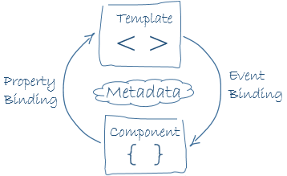
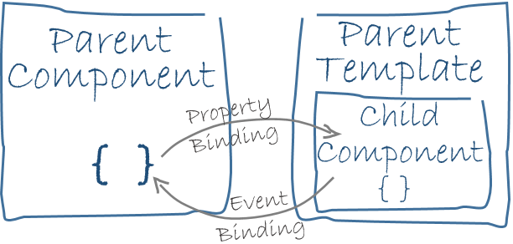
Angular 2 – Data binding

Slide 55



Angular 2 – Data binding
Notes:
Every member of a source directive is automatically available for binding. We don't have to do anything special to access a directive member in a template expression or statement.
We have limited access to members of a target directive. We can only bind to properties that are explicitly identified as inputs and outputs.
We're drawing a sharp distinction between a data binding target and a data binding source.
The target of a binding is to the left of the =. The source is on the right of the =.
Declaring input and output properties
Target properties must be explicitly marked as inputs or outputs.
When we peek inside HeroDetailComponent, we see that these properties are marked with decorators as input and output properties.
Input properties usually receive data values. Output properties expose event producers, such as EventEmitter objects.
http://victorsavkin.com/post/110170125256/change-detection-in-angular-2
http://blog.thoughtram.io/angular/2016/01/22/understanding-zones.html

Slide 56

Angular 2 – Reference Binding
Angular 2 supports defining local names in the template.
Angular 1
Angular 2
Notes:
Angular 1: no way to reference(bind) to other element => end up writing custom directive…
Angular 2: Can now access to other properties, event and methods

Slide 57
Angular 2 – Data binding
Option to read:
http://victorsavkin.com/post/110170125256/change-detection-in-angular-2
http://blog.thoughtram.io/angular/2016/02/22/angular-2-change-detection-explained.html

Slide 58
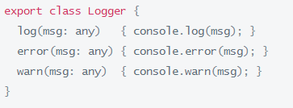
Angular 2 – Service
There is nothing specifically Angular about services. Angular itself has no definition of a service. There is no ServiceBase class.
Notes:
Almost anything can be a service. A service is typically a class with a narrow, well-defined purpose. It should do something specific and do it well.

Slide 59
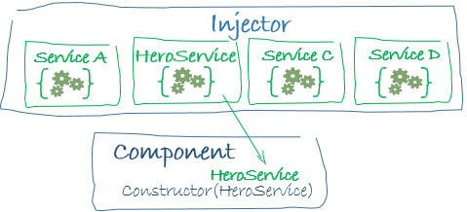
Angular 2 – Service and DI
"Dependency Injection" is a way to supply a new instance of a class with the fully-formed dependencies it requires.
Notes:
Almost anything can be a service. A service is typically a class with a narrow, well-defined purpose. It should do something specific and do it well.

Slide 60
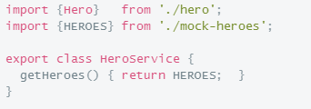
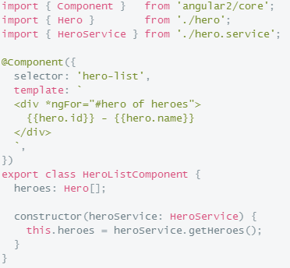
Angular 2 – Service and DI
Service
… and injection
Notes:
In fact, there is no such thing as the injector! An application may have multiple injectors!
Each component instance gets its own injector and an injector at one level is a child injector of the injector above it in the tree.
Dependencies are singletons within the scope of an injector.
The Injector is itself an injectable service.
https://angular.io/docs/ts/latest/guide/dependency-injection.html#!#explicit-injector

Slide 61
Quick start!

Slide 62
Working environment
Ide: Visual studio, Visual Studio Code(recommended), Atom, Sublime, Webstorm.
https://code.visualstudio.com/Download
Node and NPM:
https://nodejs.org/en/download/

Slide 63
Working environment
Create an application project folder
Add a tsconfig.json to guide the TypeScript compiler
Add a typings.json that identifies missing TypeScript definition files
Add a package.json that defines the packages and scripts we need
Install the npm packages and typings files
Notes:
https://angular.io/docs/ts/latest/quickstart.html

Slide 64
Working environment
npm start: run the compiler and a server at the same time, both in “watch mode”
npm run tsc: run the TypeScrupt compiler once
npm run tsc:w: watch mode: re-compiling when it sees changes
npm run lite: runs static file server
npm run typing: …
npm run post install: …

Slide 65
‘Tour of heroes’

Slide 66
Tour of heroes
Keys:
Master/detail
Multiple components
Services
Routing

Slide 67
Thanks

Slide 68
What’s more ?
Learning material
http://learnangular2.com/
https://angular.io/docs/ts/latest/guide/
Seed project:
https://github.com/mgechev/angular2-seed

